Slide 1
How to contribute to an Open Source project

Slide 2




Sean Wheeler
Principal Content Developer - PowerShell
sdwheeler
sean.wheeler@microsoft.com
swsamwa

Slide 3
What is open source?
Software (OSS)
Code designed to be:
Collaborative process
Developed in a decentralized and collaborative way
A movement
Reaches beyond the production of OSS
Free to redistribute
Modifiable
Publicly accessible
Relies on peer review and community production
Finds new ways to solve problems
Crosses communities and industries
Source: https://www.redhat.com/topics/open-source/what-is-open-source
sdwheeler
sean.wheeler@microsoft.com
swsamwa
Notes:
Open source is a term that originally referred to open source software (OSS). Open source software is code that is designed to be publicly accessible—anyone can see, modify, and distribute the code as they see fit.
Open source software is developed in a decentralized and collaborative way, relying on peer review and community production. Open source software is often cheaper, more flexible, and has more longevity than its proprietary peers because it is developed by communities rather than a single author or company.
Open source has become a movement and a way of working that reaches beyond software production. The open source movement uses the values and decentralized production model of open source software to find new ways to solve problems in their communities and industries.

Slide 4
Elements of an open source project
Traditionally volunteer driven
Community
People interested in the project
Shared mindset
Contributors
People who participate in the project
Maintainers
Project leaders
sdwheeler
sean.wheeler@microsoft.com
swsamwa

Slide 5
Benefits of getting involved
Build a public portfolio of work
The Impact GitHub is Having on Your Software Career, Right Now… | by Josh Wulf | Medium
Learn new skills
Git/GitHub, Markdown, writing docs, code languages, scripting, etc.
How to advance your career by contributing to open source projects | Opensource.com
Grow the community and your network
Recognition in the community
Improve the product for everyone
sdwheeler
sean.wheeler@microsoft.com
swsamwa
Notes:
Build a public portfolio of work
The Impact GitHub is Having on Your Software Career, Right Now… | by Josh Wulf | Medium
Working on closed source – you can’t take it with
Recruiters and hiring managers want to see examples of your work
Learn new skills
Git/GitHub, Markdown, writing docs, code languages, scripting, etc.
How to advance your career by contributing to open source projects | Opensource.com
Grow the community and your network
Recognition in the community
Improve the product for everyone

Slide 6
Understanding the project guidelines
Expectations
Understand your own motivations and desired outcomes
Etiquette - Open source etiquette - The MDN Web Docs project | MDN (mozilla.org)
Be kind and respectful
Find out how and where to ask questions
Add value, not noise
Be patient and timely
Follow the published style guides & use the same tools
The styles and tools are designed to produce consistent results
sdwheeler
sean.wheeler@microsoft.com
swsamwa

Slide 7
Getting started in Microsoft Docs
Create a GitHub account
Setup Git and VS Code (with extensions)
Read the contributor docs
Docs Contributor Guide
PowerShell-specific Contributor Guide
Using the Microsoft Doc Authoring Pack
sdwheeler
sean.wheeler@microsoft.com
swsamwa

Slide 8
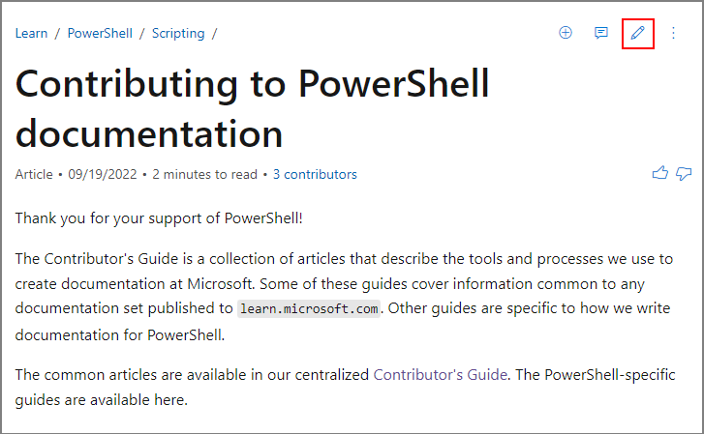
Making a simple change
Click the Edit icon on the page
Use the GitHub web interface to edit
Good for small changes to a single file
Use the full workflow for complex changes and multiple files
sdwheeler
sean.wheeler@microsoft.com
swsamwa

Slide 9
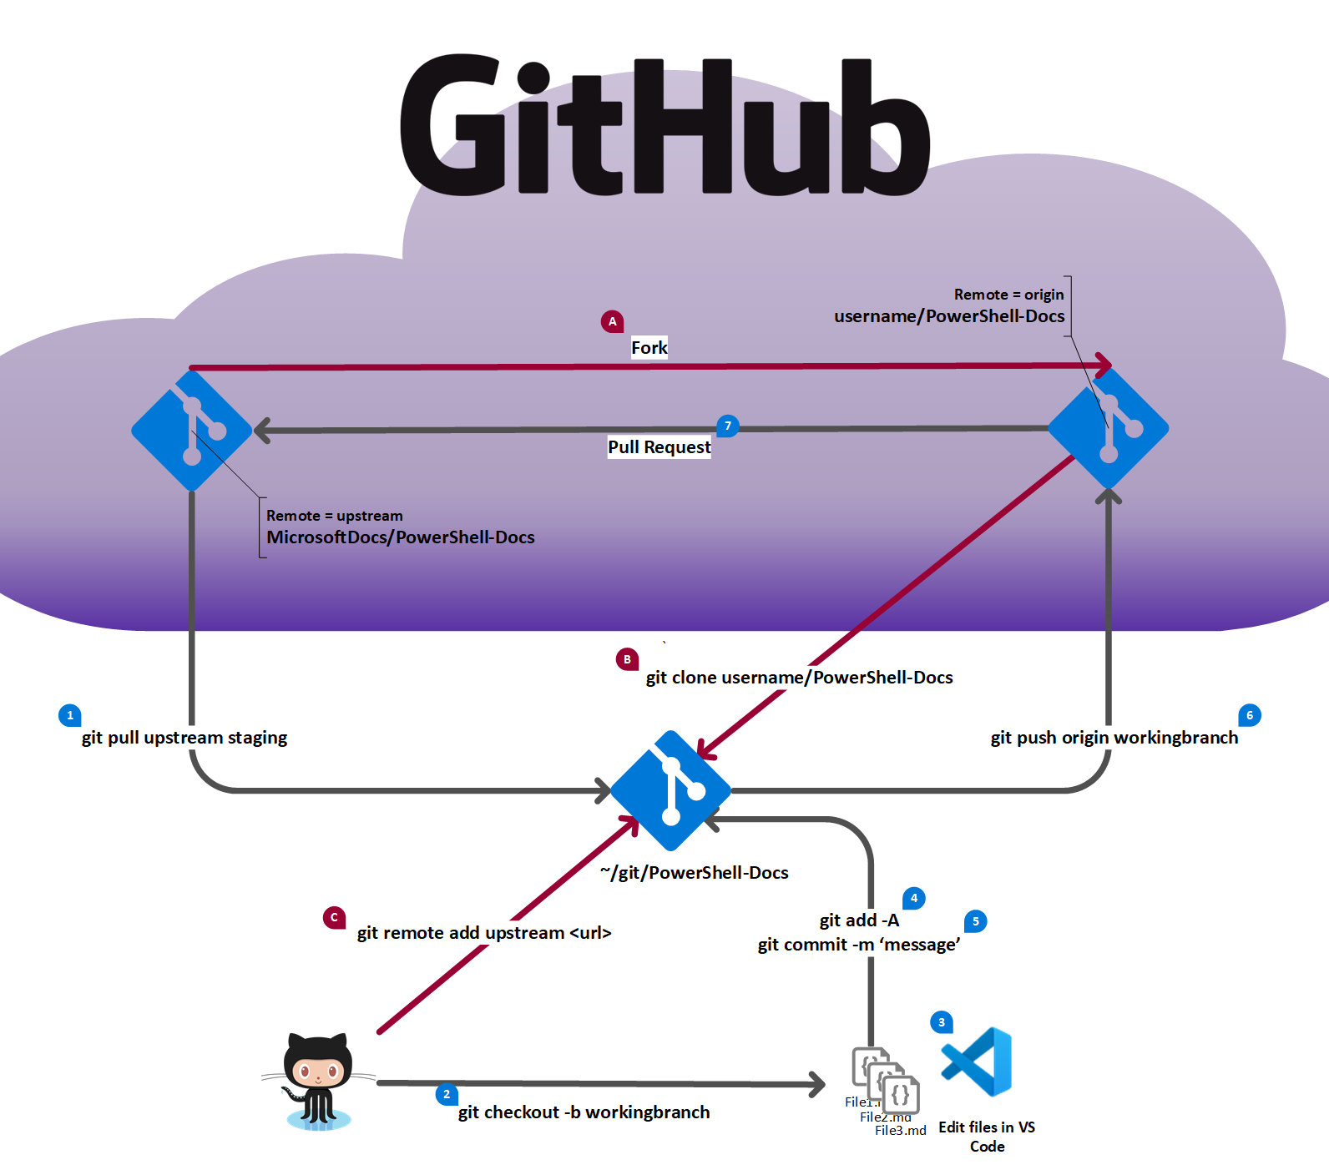
One-time setup steps
Fork the base repo
Clone your fork
Add an upstream pointer to the base
Normal workflow
Pull default branch from base repo
Create a working branch
Edit your files
Add your changes to Git
Commit your changes
Push the working branch to your fork
Create a pull request from your fork to the base repo

Slide 10
Source repositories
PowerShell repositories
Source code – PowerShell/PowerShell
Docs repositories
MicrosoftDocs/PowerShell-Docs
MicrosoftDocs/PowerShell-Docs-DSC
MicrosoftDocs/PowerShell-Docs-Modules
Azure PowerShell repositories
Source code – Azure/azure-powershell
Docs repository – MicrosoftDocs/azure-docs-powershell
Understand how the content is organized
Content types – reference and conceptual
Edit button points to Source repo for cmdlet reference
sdwheeler
sean.wheeler@microsoft.com
swsamwa

Slide 11
Demos
Markdown
Microsoft Docs Authoring Pack
Full GitHub workflow
sdwheeler
sean.wheeler@microsoft.com
swsamwa

Slide 12
Bonus - Another way to contribute
PowerShell Community Blog - Great way to start writing and get free code and content reviews
GitHub Source - https://github.com/PowerShell/Community-Blog
Blog site - https://devblogs.microsoft.com/powershell-community/
Hacktoberfest – https://hacktoberfest.com/about
Hacktoberfest and Microsoft Learn - Contributor Guide | Microsoft Learn
List of beginner repositories: https://up-for-grabs.net
sdwheeler
sean.wheeler@microsoft.com
swsamwa

Slide 13
Key takeaways
Read the contributor & style guides
Docs Contributor Guide
PowerShell-specific Contributor Guide
Microsoft Style Guide
The process is the same for contributing to any learn.microsoft.com content
Only difference would be content-specific styling
PowerShell content is everywhere – Azure, Office, Windows, SQL, etc.
sdwheeler
sean.wheeler@microsoft.com
swsamwa

Slide 14
Resources & Links
Tools
Visual Studio Code – https://code.visualstudio.com
Vale - Vale.sh - A linter for prose & VS Code extension - Vale - Visual Studio Marketplace
Docs Authoring Pack - Visual Studio Marketplace
Markdown resources
Markdown reference
CommonMark Specification
Git/GitHub
GitHub Git Cheat Sheet
How to write the perfect pull request | The GitHub Blog
sdwheeler
sean.wheeler@microsoft.com
swsamwa

Slide 15
sdwheeler
sean.wheeler@microsoft.com
swsamwa

